Slide 1
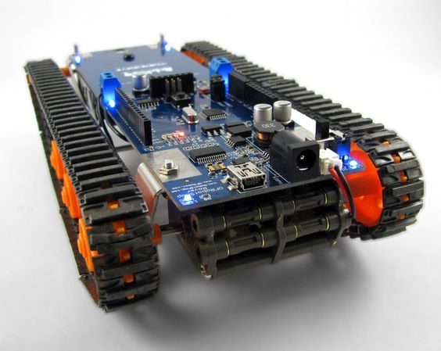
The Design of a Ground Rover with TI mmWave Radar Sensor for Geographical Acquisition in Disaster Rescue Applications
FAVOUR DADA
JESUDARA OMIDOKUN
ADURALERE SULAIMAN

Slide 2
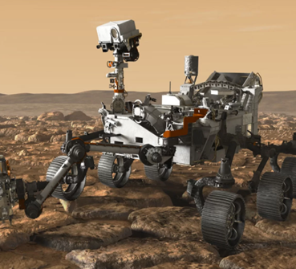
OUTLINE
Background
Objective
Design Requirements
Design Constraints
System Diagram
Team Organization
Timeline
Implementation Plan
Implementation of Tasks
Future Plans
Conclusion
Questions and Answers

Slide 3
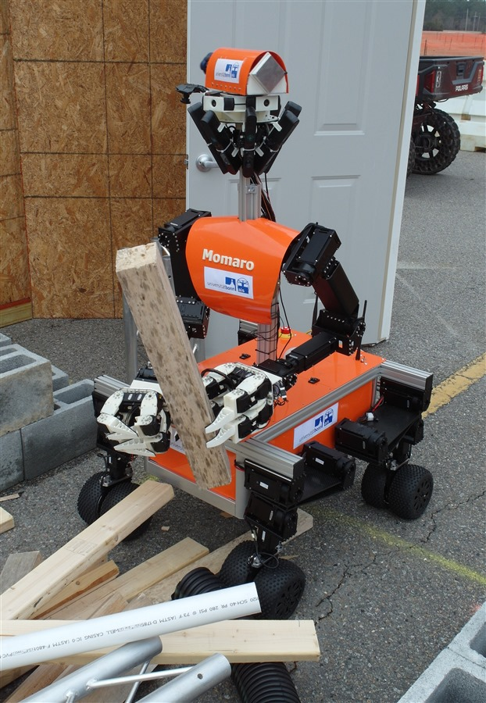
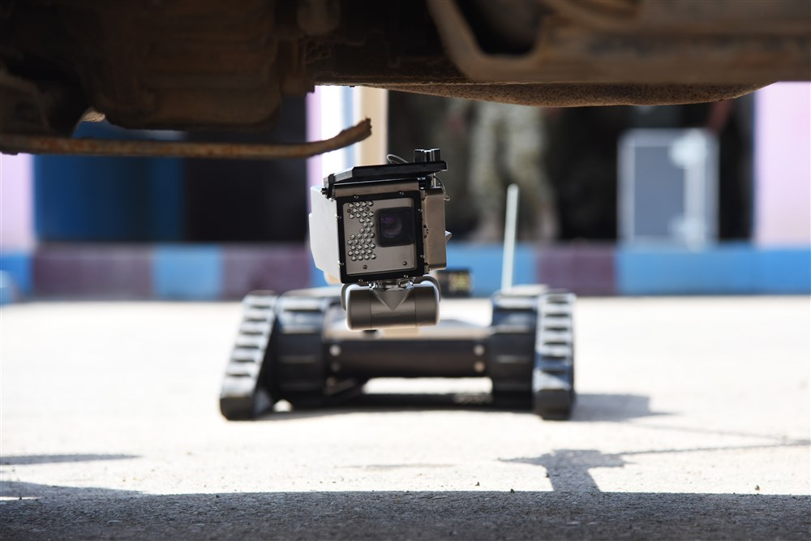
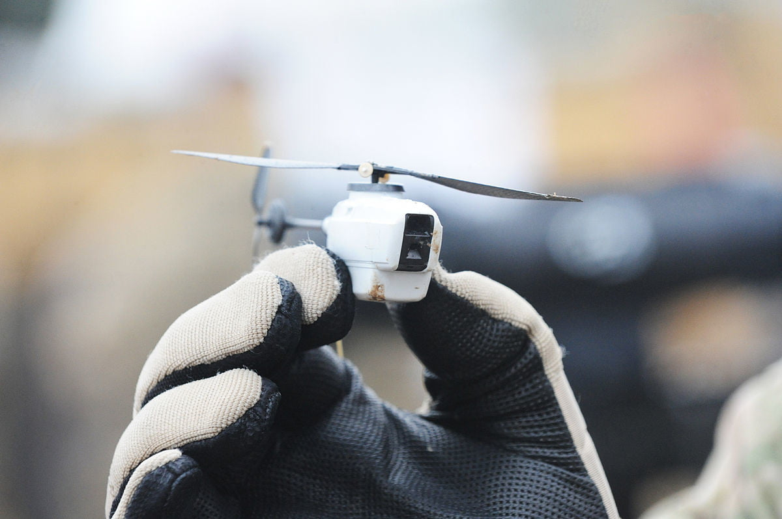
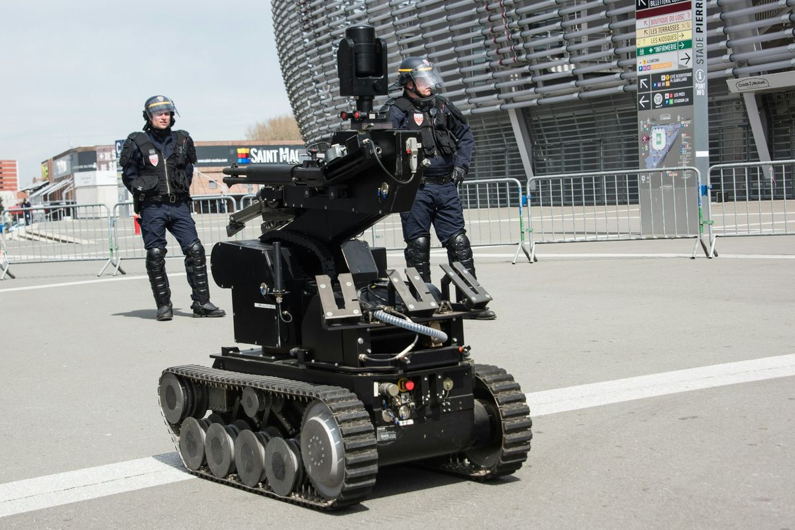
Background
A robot used to diffuse Bomb
Hornet drone used for engaging targets without human intervention
Momaro robot used in disaster rescues
The robot that Dallas Police used to kill a terrorist who killed 5 officers and wounded nine others

Slide 4
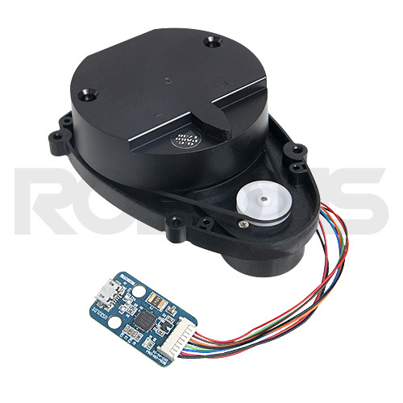
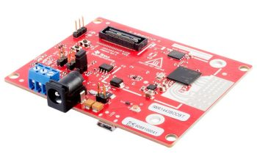
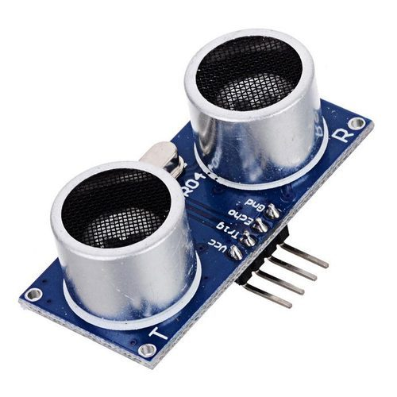
Background
mmWave was selected for this project because of its long obstacle detection range, angle, range, unlike most sensor technology such as ultrasonic sensors, Lidar etc.
ultrasonic sensor
360 laser distance sensor(Lidar)
IWR1443BOOST

Slide 5
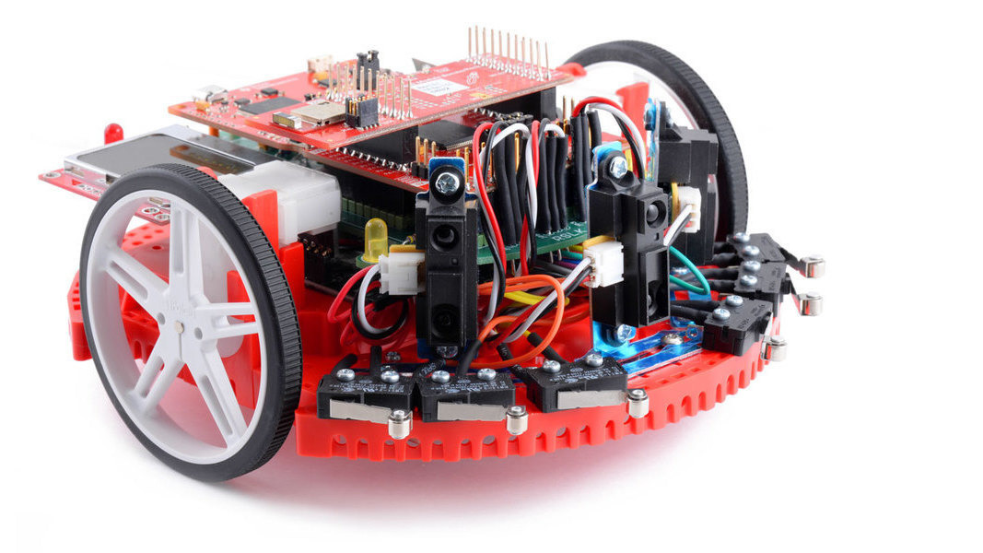
Objective
The objective of the project is to design a rover that can acquire geographical information such as the range, velocity,angle and 3D imaging of objects in an unknown area.

Slide 6
Design Requirements
Payload: 15-20lbs
Object Detection Range: 3cm to 10m
Avoid Obstacle While Autonomously Navigating
Resolution Range: 10cm
Produce data using a point cloud information
Battery will run for four hours

Slide 7
Design Constrains
The tires might not be able to move well in certain terrains such as rocky areas
Battery will have to be recharged after use
Device would only work in mild weather conditions

Slide 8
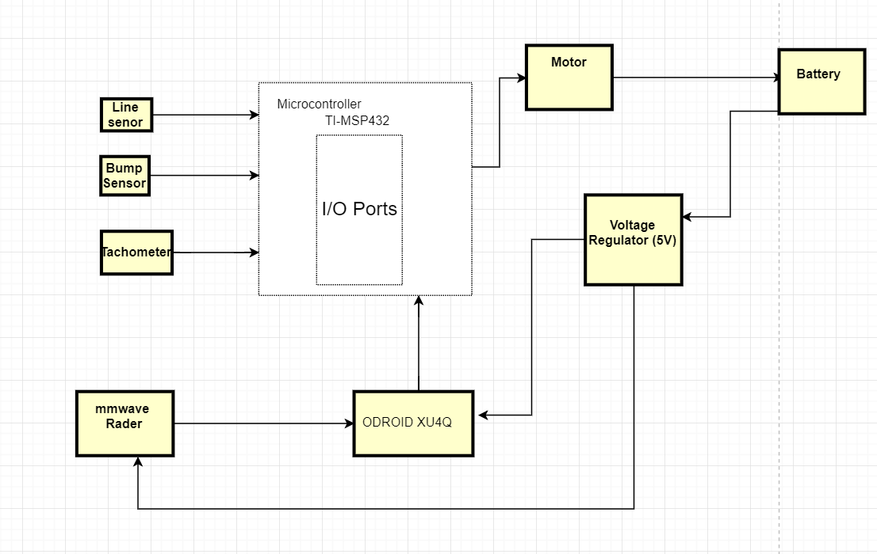
System Diagram

Slide 9
Design Tasks
Task 1. RLSK Assembly
a. Subtask 1. Soldering, Assembling and Wiring of TI RSLK Kit
b. Subtask 2. Writing and Modifying the Code for Bumps Sensors.
c. Subtask 3. Writing and Modifying of the Code for Line Follow Sensor.
Task 2. Design of the computer system
a. Subtask 1. Setting up Ubuntu on ODROID XU4Q
b. Subtask 2. Implementing the mmWave interface with the microcomputer

Slide 10
Task 3. Implementation and development of the mmWave sensor (IWR 1443 Boost)
c. Subtask 1. Mounting the mmWave to RSLK board
d. Subtask 2. Design and print a 3d part to help mount the mmWave
Task 4. Acquisition of the point cloud data from the radar with the microcomputer.
Task 5. Stitching the acquired data.
Task 6. Detecting and calculating the distance of an object behind the glass wall.
Task 7. Using the Tachometer to calculate the speed of the rover.
Task 8. System Finalization, testing and refinement.

Slide 11
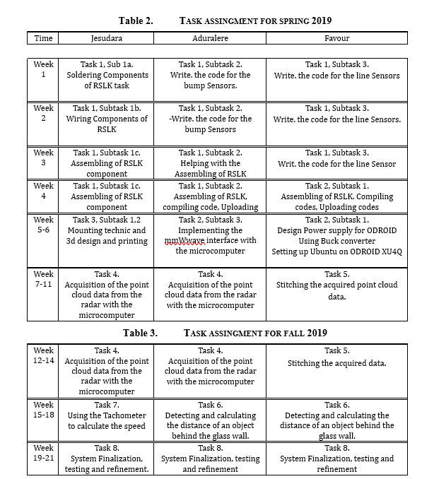

Slide 12
Implementation

Slide 13
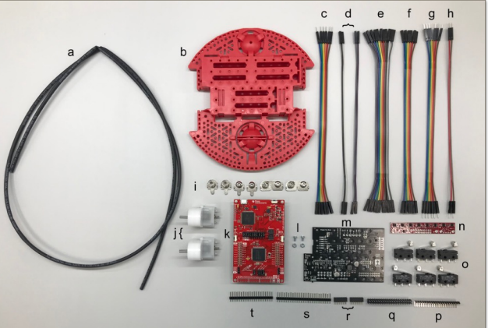
Task 1: RSLK Assembly

Slide 14
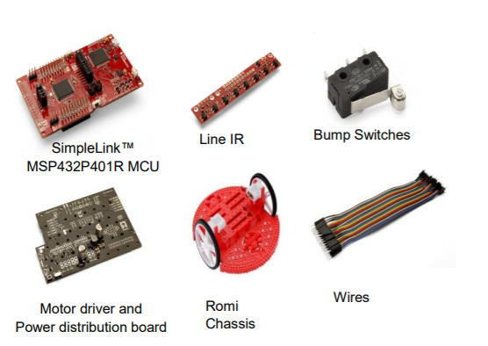

Slide 15
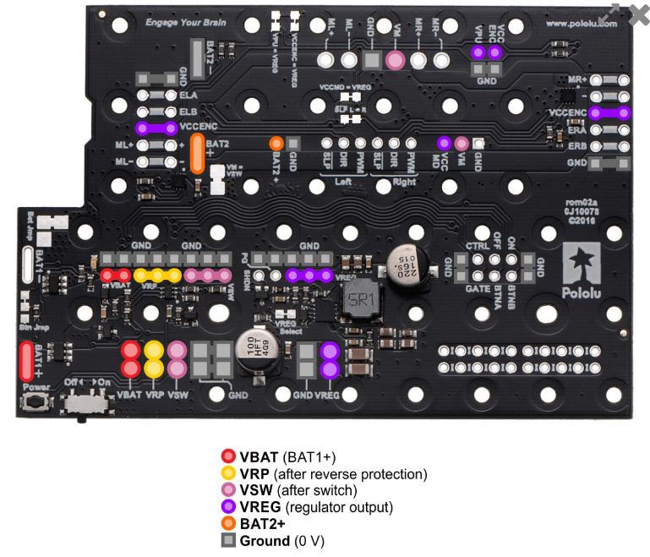
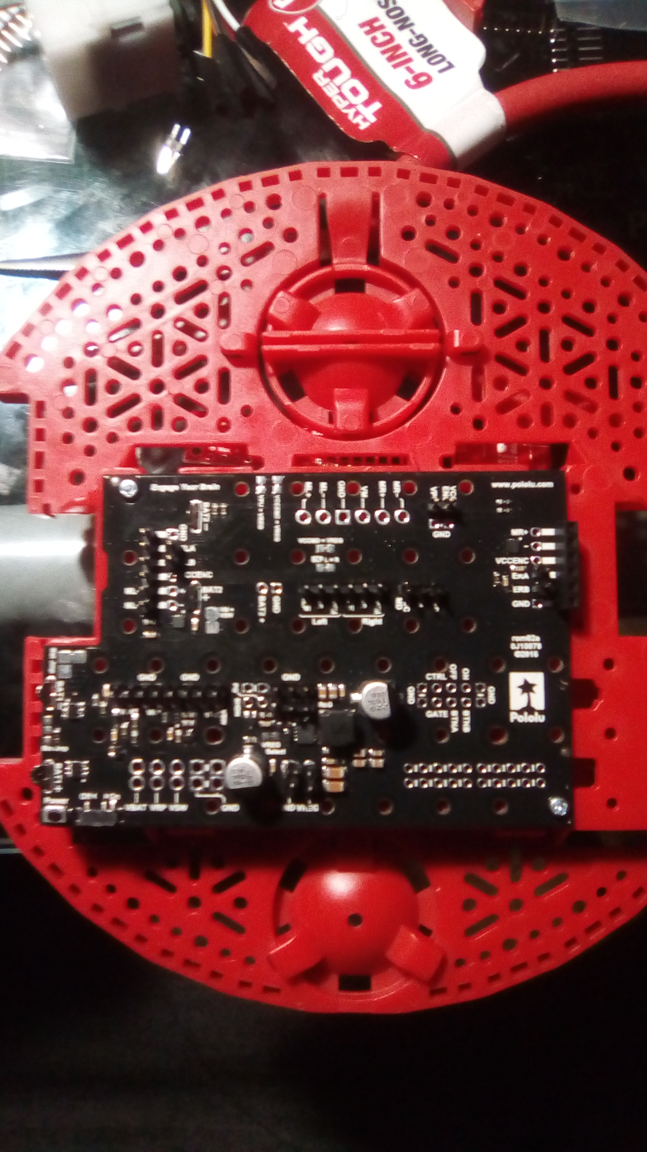
Motor Board
A Complete soldered Motor Drive and mounted to the Chassis

Slide 16
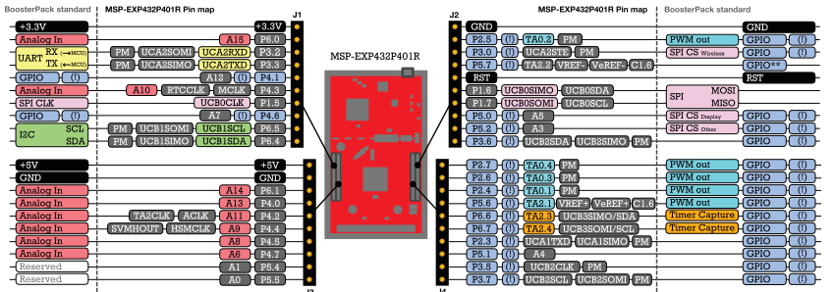
The Microcontroller (MSP EXP432) Pin map and its Functions

Slide 17
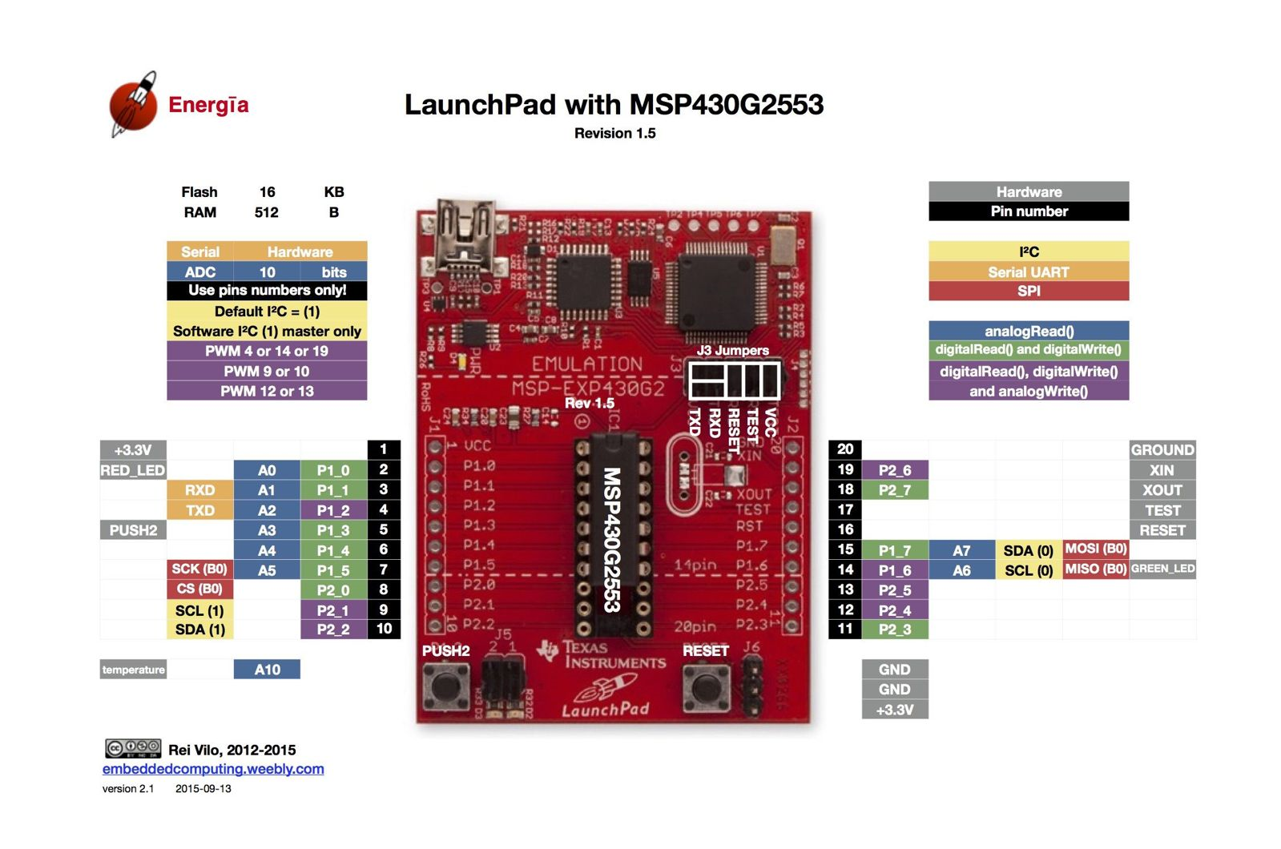

Slide 18
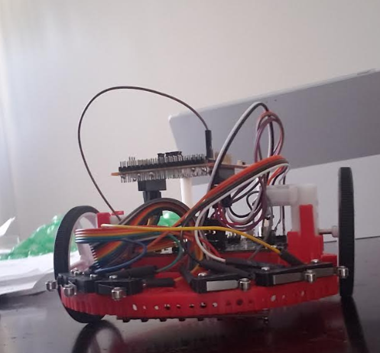
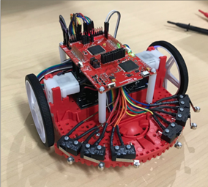
The Complete Assembly of RSLK Kit
Built RSLK Kit with all the sensors and LaunchPad

Slide 19
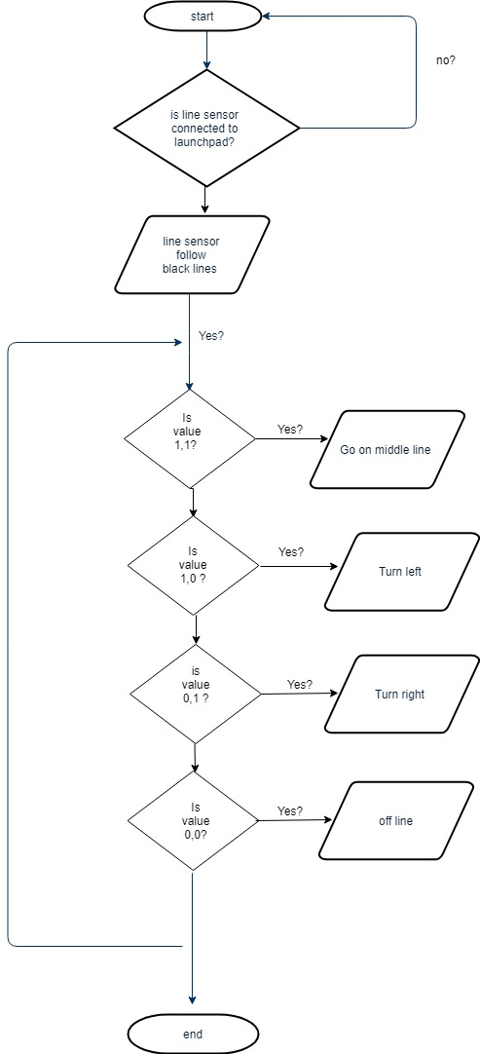
Implementation of Line Tracking Module

Slide 20
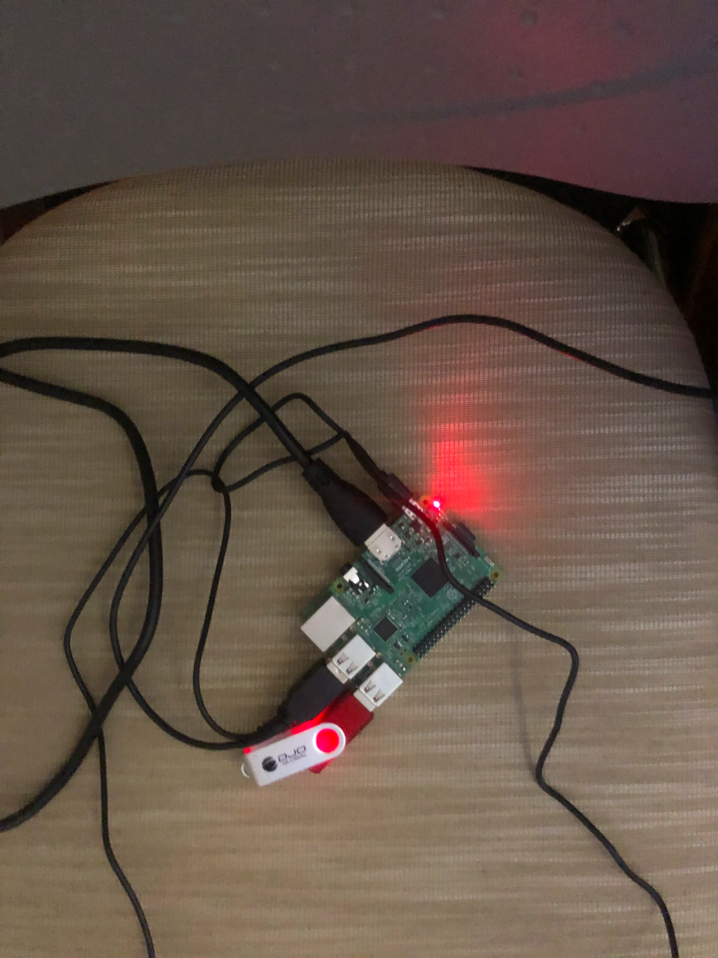
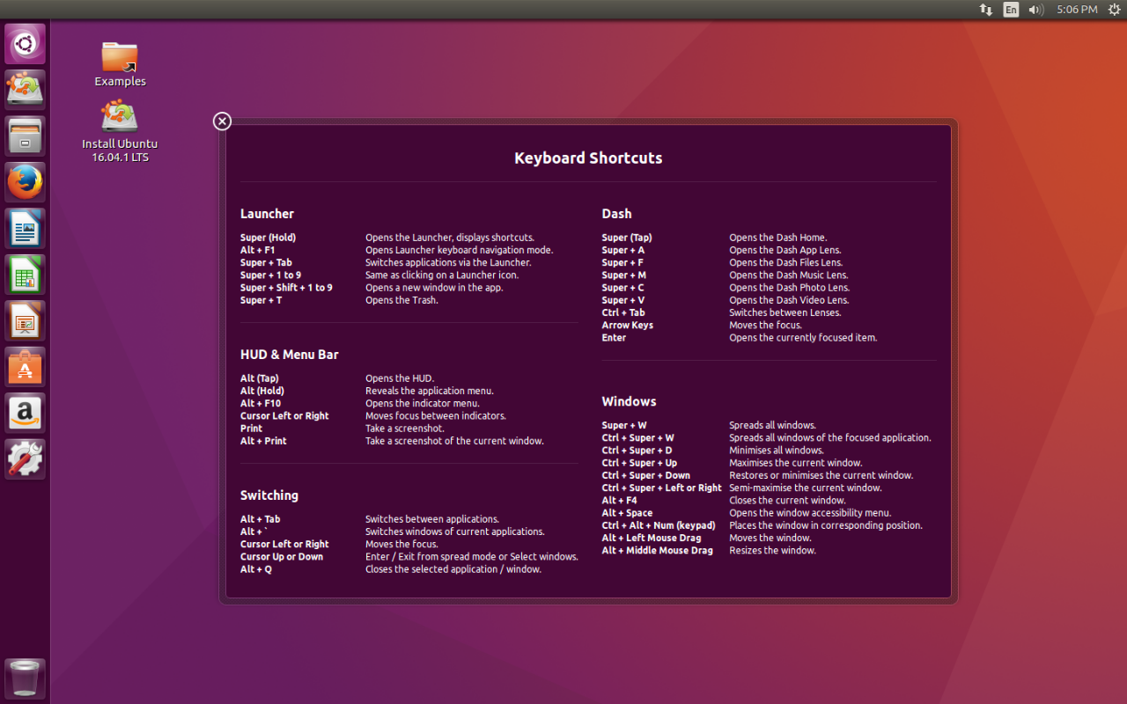
Implementation of Ubuntu

Slide 21
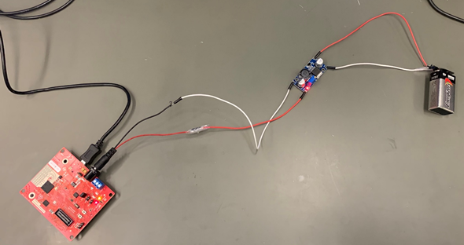
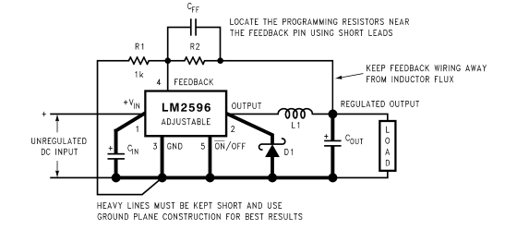
Implementation of Buck Converter

Slide 22
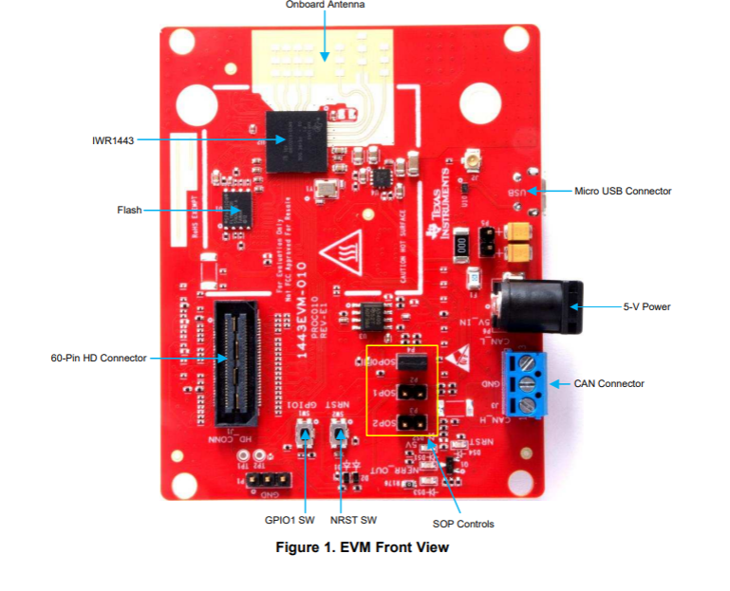
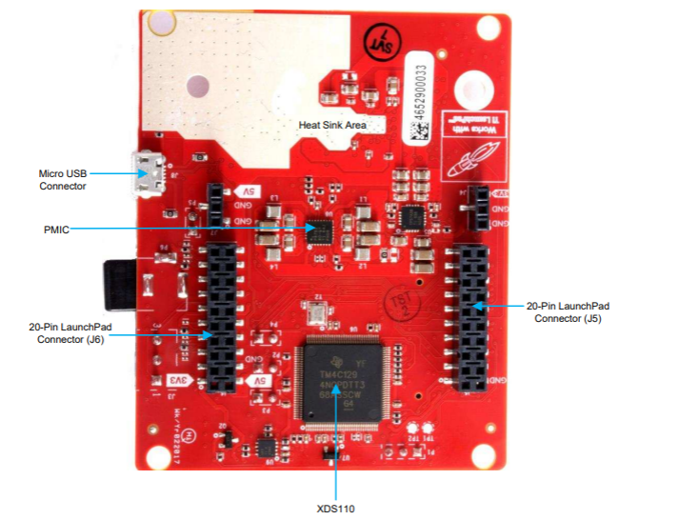
Views of the mmWave (IWR1443)
Front View
Back View

Slide 23
Implementation of the mmWave
Some of the specs of the mmWave are;
Tuning frequency of 76-81 GHz
4 Receivers & 3 Transmitters
40-pin launchpad standard that leverages the Launchpad ecosystem
XDS110-based JTAG emulation with serial port, for onboard QSPI flash programming
0nboard antenna
Key features of the mmWave include;
76- to 81-GHz Coverage With 4-GHz Continuous Bandwidth
Backchannel UART through USB to PC, for logging purposes
On-Chip Programmable Core for Embedded User Application
Radio processor for built-in Calibration and Self-Test
One button and two LEDs, for user interaction

Slide 24
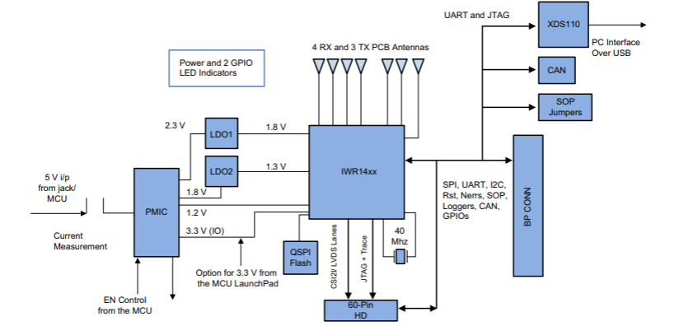
Block Diagram of mmWave sensor

Slide 25
Requirements to generate point cloud data
Host PC (laptop or desktop)
USB to microUSB cable
5V power supply (center positive barrel jack, 2.5A)
Ubuntu 16.04 LTS operating system
Robot Operating system (ROS)
ti_mmwave_rospkg source code
mmWave SDK software
UniFlash

Slide 26
Visualizing the point cloud data
Install bootstrap ROSDEP on PC
ROS kinetic kame
Create Workspace
Flash mmWave using UniFlash
Install ti_mmave_rospkg_.zip ROS driver
ROS workspace environment
Import radar file provided by TI
Generate the point cloud data using rosrun rviz rviz

Slide 27
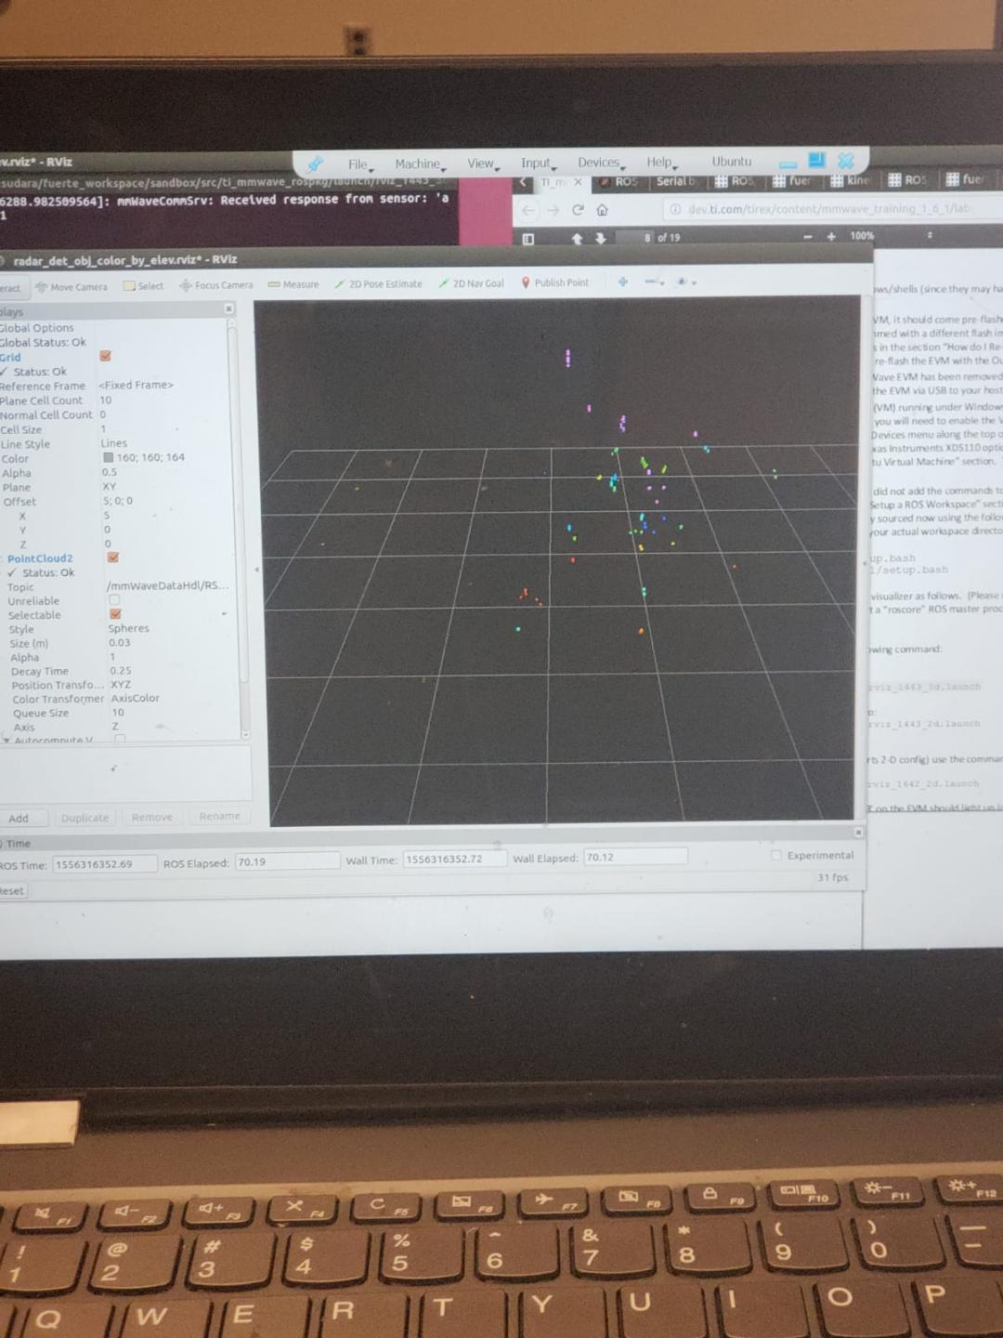
ACQUIRING 3D VISUAL DATA FROM mmWave

Slide 28
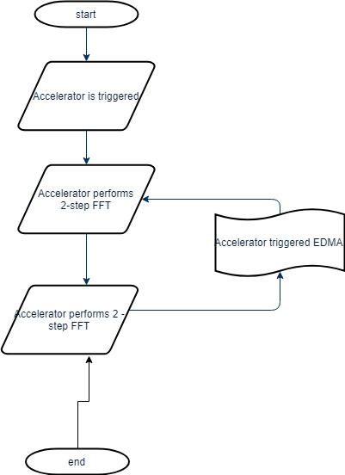
Implementation of Task 5.2
Install UniFlash on PC
Flash mmWave using UniFlash
Load prebuilt in binaries
Load on Configured code on Demo Visualizer
Move reflective objects in front of mmWave to see how it responds

Slide 29
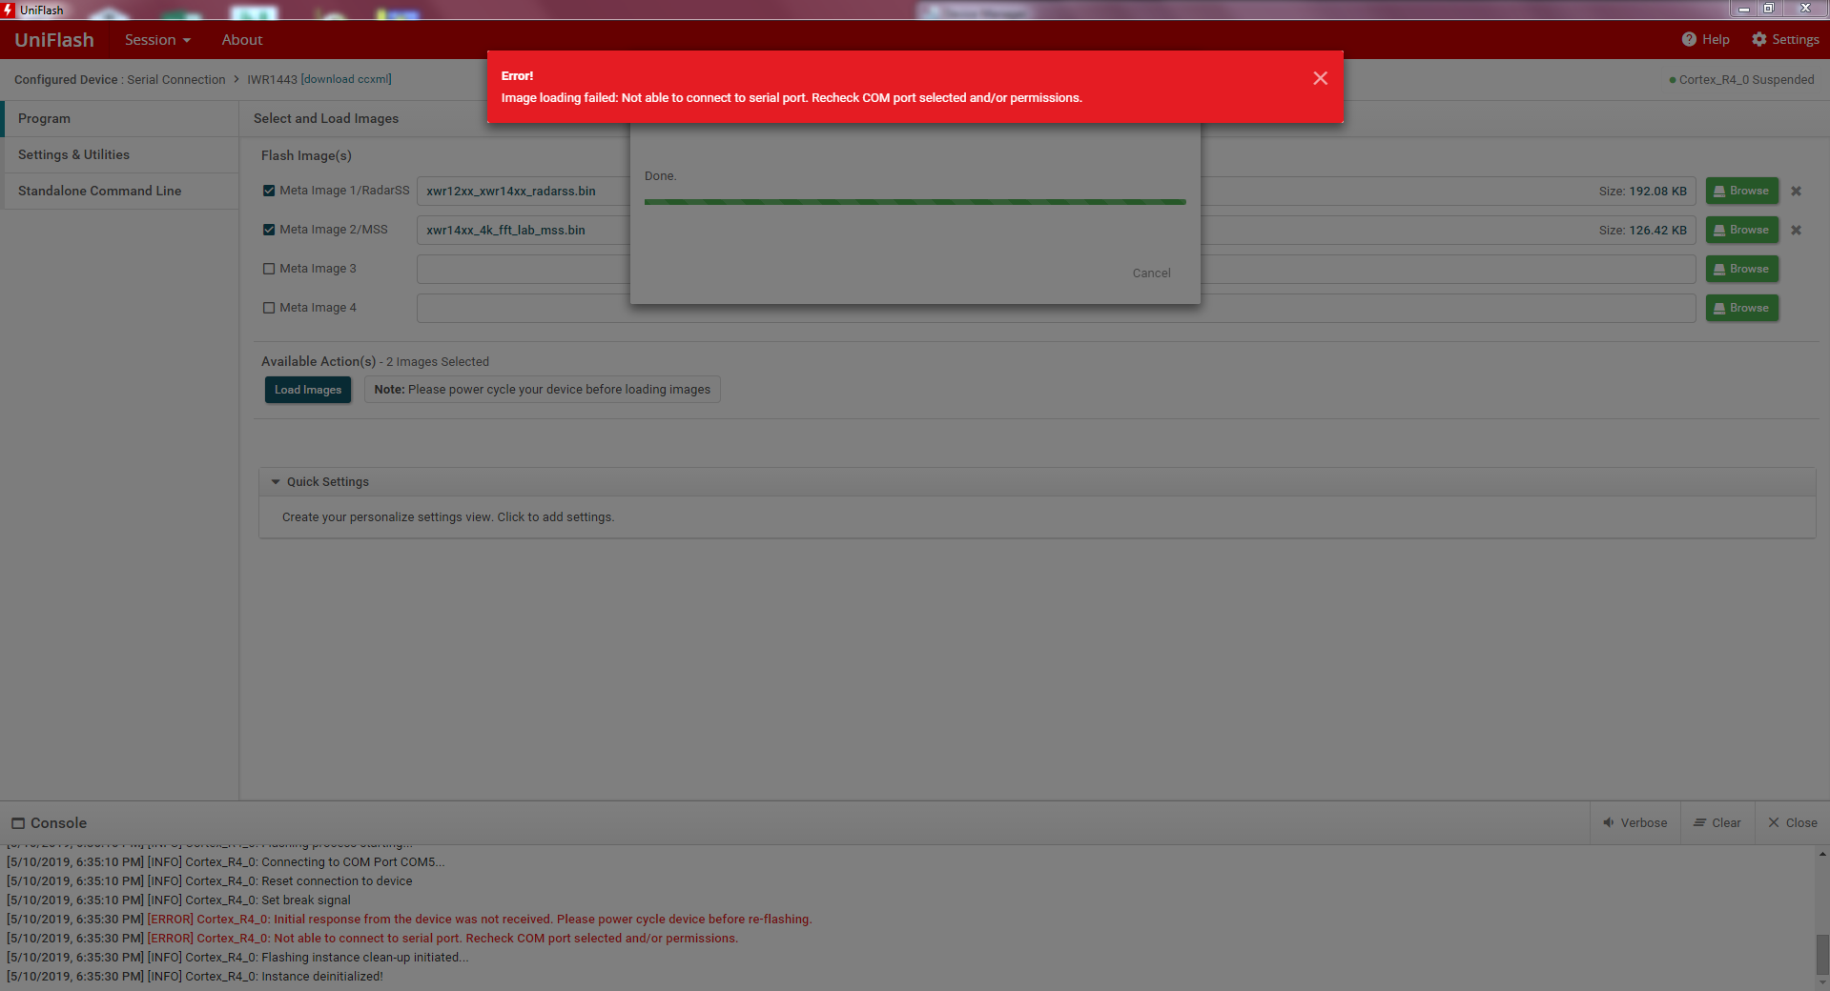
Error messages from Task 5.2

Slide 30


Slide 31
FUTURE PLANS

Slide 32


Slide 33


